Slide 1
Cascaded Style Sheets

Slide 2
Cascaded Style Sheets
It allows web developer to control the style and layout of multiple web pages.
Styles define how to display HTML elements and are normally stored in style sheets.
    Advantages
        Enables you to separate content from formatting
        Reduces download time by removing formatting information from the document
        Allows you to ensure a consistent appearance across a site.

Slide 3
Defining style
    A rule is a statement that defines a style.
    It consists of two parts
    1) Selector(HTML element linked to a particular style)
      2) Declaration
Property Name
Property value
      H1 { color : red }
Selector
Declaration

Slide 4
Ex:
<h1> this is a heading </h1>
To make above heading underlined in blue with background color yellow,
Style can be defined as
h1{ color:blue; text-decoration:underline; background:yellow}
So heading will take all these properties with values mentioned.

Slide 5
Ways to define Style Sheet properties
    5 ways :
    Using Inline style
    Using Internal style
    Using external style
    Using style class
    Div tag

Slide 6
Ways to define Style Sheet properties
    Using Inline style:
    1) The style included within the tag is known as inline tag using style attribute
    2) Ex:
    To define a style for a <p> tag for font-face arial and text italicized.
    <p style="font-family:arial;font-style:italic"> this came from a paragraph tag with a style</p>
    Inline style affects only the element for which the style is defined.

Slide 7
Ways to define Style Sheet properties
Using Internal style:
The style definition are enclosed in<style>…</style> tags
This tag pair is placed inside a <head> tag.
The style definition mentioned in <style> tag can be used for entire document.

Slide 8
Using Internal style:
Ex:
    <head>
    <style type=“text/css”>
    H1{ font-style:italic; background:yellow;color:red}</style>
    </head>
The type attribute identifies the content between the <style> and </style> tags.
The value "text/css" indicates that the content is CSS.

Slide 9
Ways to define Style Sheet properties
Using External style:
Style definition are stored in separate file with .css extension.
This .css file is added to a HTML document using <link> tag which placed in <head> tag.
Ex:
h1 {
background-color: red;text-align:center;}
P{ background-color:purple}
This above contents are placed in separate file as say style.css

Slide 10
Ways to define Style Sheet properties
Using External style:
This style.css is included in html document as follows:
<head>
<link rel=stylesheet href="style.css" type="text/css">
</head>
Rel specifies that document will use style sheet.
Href mentions file which has defined style sheets.
Type=“text/css” specifies that document refers to a .css file for picking up style definitions.

Slide 11
Ways to define Style Sheet properties
Using style classes:
1) There are two types of style class creation :
a) Universal
b) Element specific
2) To apply a style for HTML element ,class attribute is used of same HTML element.
a) Universal style class(must be in head tag):
        <style>
        .classname{class definition}
        </style>

Slide 12
Ways to define Style Sheet properties
Using style classes:
Ex of Universal class:
<head>
<style>
.Myclass{fontfamily:arial;color:green;background:yellow}
</style>
</head>
To apply a class to an element:
<p class=“Myclass”>this is my class</p>

Slide 13
Ways to define Style Sheet properties
Using style classes:
b) Element specific style class:
Syntax:
<style>
elementname.classname{class definition}
</style>

Slide 14
Ways to define Style Sheet properties
Using style classes
Ex of element-specific style class:
<head>
<style>
th.color{background-color:red}
</style>
</head>
To apply above style class:
<th class=“color”>name</th>
<th class=“color”>date of birth</th>
<th class=“color”>City</th>

Slide 15
Ways to define Style Sheet properties
Using style classes:
Another ex of element-specific style class:
<head>
<style>
element name.center {
text-align: center;
color: red;}
</style>
</head>
To apply above style class to paragraph :
p.center { text-align:center; color:red;}

Slide 16
CSS Selectors
1) The element selector:
The element selector selects elements based on the element name.
You can select all <p> elements on a page like this: (all <p> elements will be center-aligned, with a red text color)
Ex:
p {
text-align: center;
color: red;
}

Slide 17
CSS Selectors
Grouping selector:
In style sheets there are often elements with the same style:
h1 {
text-align: center;
color: red;
}
h2 {
text-align: center;
color: red;
}
p {
text-align: center;
color: red;
}
h1, h2, p {
text-align: center;
color: red;
}
Way of grouping selector.

Slide 18
CSS Selectors
2) The id Selector
The id selector uses the id attribute of an HTML tag to find the specific element.
An id should be unique within a page, so you should use the id selector when you want to find a single, unique element.
To find an element with a specific id, write a hash character, followed by the id of the element.
The style rule below will be applied to the HTML element with id="para1":

Slide 19
CSS Selectors
Example
        <head>
        <style>
        #para1 {
        text-align: center;
        color: red;}
        </style>
        </head>
        <body>
        <p id=“para1”>this is WDL lecture</p>
        </body>

Slide 20
DIV tag

Slide 21
Use of div tag
The div is a generic block-level element.
It is used in the <body>section to make sections of web page.
Div tag can use following attributes for making sections:
  id attribute
  style attribute

Slide 22
Typical Web Page (Browser)
Container
header
menu
main
footer
Notes:
Cascading Style Sheets: Pixel-Level Control with HTML Ease

Slide 23
DIV tag using id attribute
Typical HTML Web page is made up of containers (boxes) or DIVs. Each DIV is assigned an ID or a Class.
<div id=“container”>
<div id=“header”>Insert Title</div>
<div id=“main">content
<div id=“menu”>content</div>
</div>
<div id=“footer”>content</div>
</div>

Slide 24
Div tag using id attribute
In the CSS file the Div tag using id attribute is used to style the elements.
To style the HTML elements, # is used with id tag in CSS file to set the property values.
#container {property: value;}
#menu {property: value;}
#main {property: value;}
#footer {property: value;}

Slide 25
List of properties
Background
color
Width
Padding
Margin
Border-width
Border-color
Border-style
These are also called as CSS Box Properties

Slide 26
HTML CSS
#content {
background-color: #ccc;
margin-bottom: 10px;
border: 1px dashed blue;
color: #fff;
width: auto;
}
div id=“header”
div id=“content”
div id=“footer”
Notes:
Cascading Style Sheets: Pixel-Level Control with HTML Ease

Slide 27
Common CSS Layout Properties used with Div tag
Width
Height
Border
Padding
Margin
Float
Clear
margin
padding
width
height
border
Notes:
Cascading Style Sheets: Pixel-Level Control with HTML Ease

Slide 28
Width & Height
Width and height define the width and height of an element.
div id=“box”
#box {width=“50%”}
#box {width=“50em”}
#box {width=“100%”}
#box {width=“auto”}
#box {height=“auto”}
Width and height can be specified in pixels, ems, percentages or set to auto
Notes:
Cascading Style Sheets: Pixel-Level Control with HTML Ease

Slide 29
Border (top, right, bottom, left)
div id=“box”
#box {
border: red dotted 1px;
#box {
border-color: red;
border-style: dotted;
border-width: 2px;
#box {
border-top: red dotted 1px;
border-bottom: red dotted 1px;
border-left: red dotted 1px;
border-right: red dotted 1px;
}
Notes:
Cascading Style Sheets: Pixel-Level Control with HTML Ease

Slide 30
Padding (top, right, bottom, left)
Padding is the space between the text/content and the border. You can use padding for all around the element or specify each side of the rectangle separately.
The code could be any of the following:
padding
padding: 10px;
or
Padding: 10px 10px;
or
padding: 10px 10px 10px 10px;
or
padding-left: 10px;
padding-right: 10px;
padding-bottom: 10px;
padding-top: 10px;
div id=“box”
Notes:
Cascading Style Sheets: Pixel-Level Control with HTML Ease

Slide 31
Margin (top, right, bottom, left)
Margin is the space outside the text/content and the border. You can use margin for all around the element or specify each side of the rectangle separately.
The code could be any of the following:
margin
margin: 10%;
or
margin: 10% 10%;
or
margin: 10% 10% 10% 10%;
or
margin-left: 10%
margin-right: 10%;
margin-bottom: 10%;
margin-top: 10%;
div id=“box”
Notes:
Cascading Style Sheets: Pixel-Level Control with HTML Ease

Slide 32
DIV with style attribute
<div style="float: right;">Monday, 14th February 2011</div>
<div style="font-size: 2em;">HTML <em>div</em> element.</div>
<div style="color: green;">
<p>This element is very useful when designing tableless layouts.</p>
<p>Don't forget to check its reference on HTMLQuick.com.</p>
</div>

Slide 33
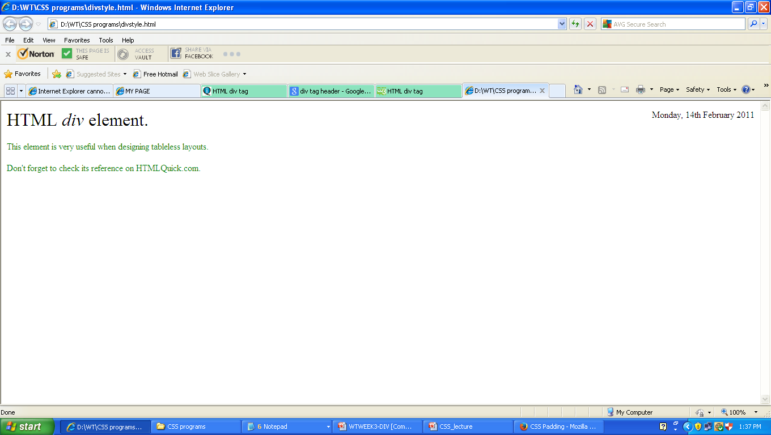

Slide 34
Clear: (left, right, both)
1. The CSS clear property defines whether a block-level element should be moved down on the HTML page to clear a floated element.
2. The syntax of clear property is :
clear: value;
3. The value can be:
left ,right,both,none,inherit
4.Ex:
div { clear: left; },
div { clear: right; }
div { clear: both; }
Notes:
Cascading Style Sheets: Pixel-Level Control with HTML Ease

Slide 35
float: (left, right, both)
1. Float Property:
The float property in CSS is used for positioning and layout on web pages.
2. Values:
none: the element does not float. This is the initial value.
left: floats the element to the left of its container.
right: floats the element to the right of its container.
inherit: the element inherits the float direction of its parent.
Ex:
This is demo shows an article with two images: one set to float: left, and one set to float: right. Press the "toggle floats" button to toggle the floats off and on.
Notes:
Cascading Style Sheets: Pixel-Level Control with HTML Ease

Slide 36
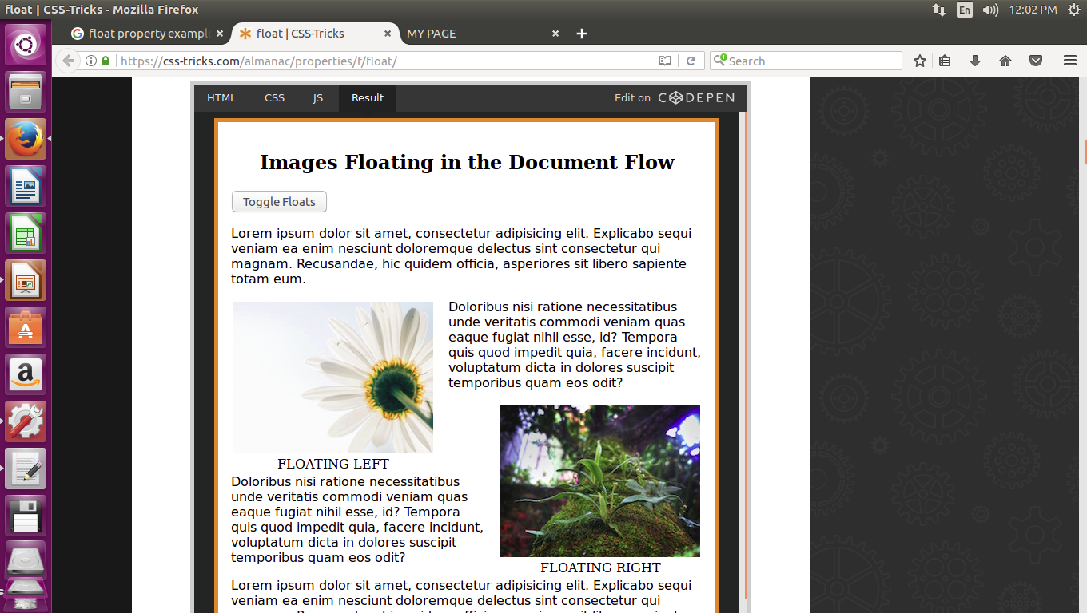

Slide 37
